Slide 1
Games Development Practices
Sound Effects
CO2301 Games Development 1
Week 17

Slide 2
Today’s Lecture
What is Sound
Digital Sound Representation
Stereo / 3D Sound
Special Effects
DirectSound

Slide 3
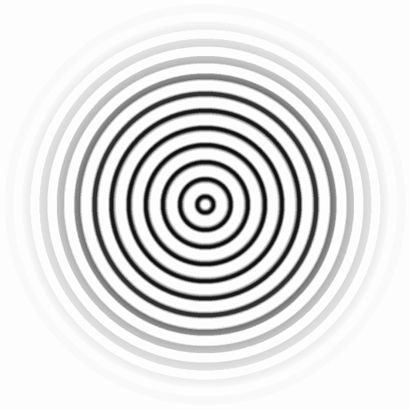
What is Sound?
Sound is caused when a vibrating object creates waves of pressure.
These waves travel through the air (or other medium)
  Speed of sound in air ~340 m/s
  Water 1480m/s, Steel 4000m/s
The waves radiate outwards from their source in a spherical manner
The pressure waves diminish with distance

Slide 4
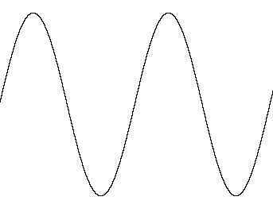
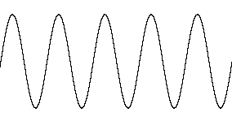
How do we Perceive Sound?
Our ears are very sensitive to such pressure waves
The volume of a sound is determined by the amount of pressure variation
  the amplitude of the waves
The pitch of a sound (how high or low it is) is driven by how quickly the pressure varies
  the frequency of the waves
Louder
Quieter
Higher Pitched

Slide 5
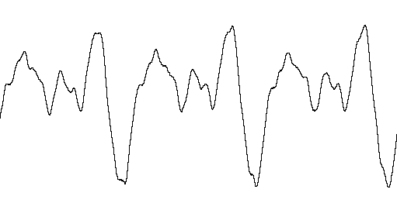
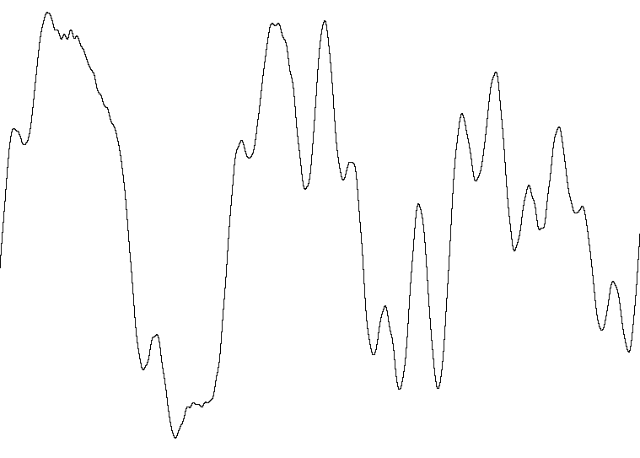
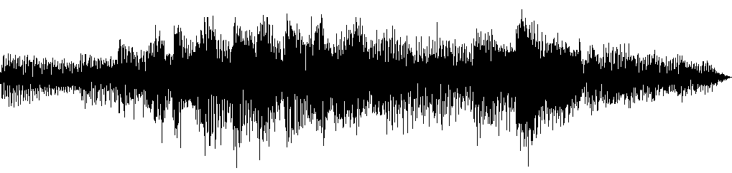
Waveforms
Draw waveforms to represent the pressure variation created at the source
Simple waveforms (like the last few) make very simple sounds
Real-world sounds have much more complex waveforms
  And waveform is densely packed
Computers cannot store these analogue waveforms, they use a digital representation instead…
Acoustic Guitar
Electric Guitar
Guitar Clip

Slide 6
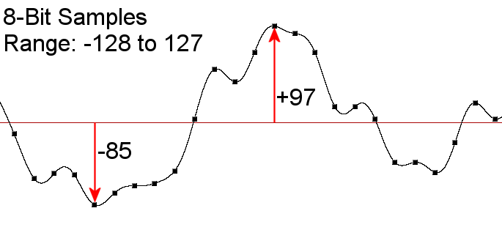
Sampling a Sound
A computer stores a sound by sampling the waveform
A sample is just the measurement of a waveform at a given time
Samples taken at a fixed sample frequency (rate)
  e.g. CDs sampled at 44100Hz : 44100 samples / second
Each sample is a value representing the amplitude (pressure) of the waveform at that point
Samples are usually integers
  Hence they have a max/min value – not realistic

Slide 7
Digital Sound Quality
Higher sample rates result in a better approximation to the original sound and hence a better quality sound
  Nyquist criterion: sample rate must be greater than 2 x required max frequency in the sound
  Typical sample frequencies: 11,000->48,000Hz
The bit-depth of the samples is the number of bits used for each sample and determines the accuracy of each sample
  E.g. An 8-bit, 16-bit or even floating point value for each sample
A higher bit-depth will also improve digital sound quality
  But improvement is less than the effect of increasing sample rate

Slide 8
Stereo Sound
Each ear receives a different waveform from a single sound
If the sound is off-centre then the sound waves will reach one ear sooner (and louder)
Also, our head is an obstacle for the pressure waves and they distort when passing by
  So the position of the head relative to the sound affects the received waveforms at each ear
We can model this difference by recording stereo sound: 2 waveforms, one for each ear
  Greatly improves sound quality
But pre-recorded sound is statically positioned…

Slide 9
3D Sound
Can dynamically model the different sounds received by our ears:
  We first consider the 3D position of the sound source
  Then calculate how the sound emitted will be perceived at each ear of the observer
Need to take account of:
  The 3D position of the sound relative to the observer
  The head position (HRTF – head related transfer functions are used here)
  Any obstacles in the way (e.g. walls)
These calculations can be performed in hardware
Can then model dynamic sound in our 3D scenes

Slide 10
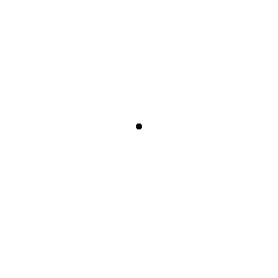
The Doppler Effect
We have considered the relative 3D position of a sound source
But the relative velocity also has an effect on the perceived sound:
  Sounds moving towards an observer are higher in pitch
  Those moving away are lower in pitch
The waves are compressed / stretched by the movement:
This should also be modelled to create a compelling 3D sound
Also typically supported in hardware
Animation by Dr. Dan Russell, Kettering University

Slide 11
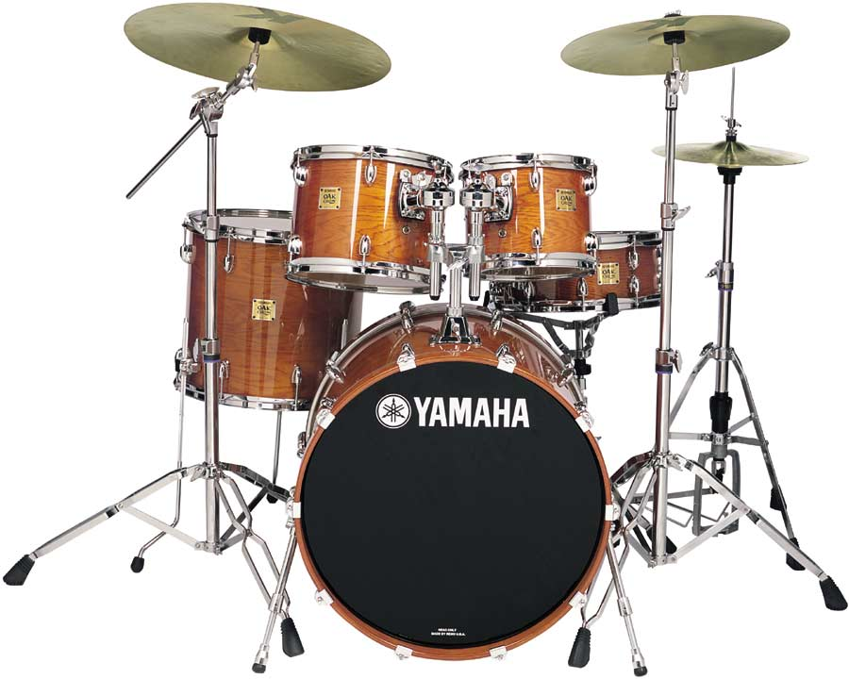
Other Special Effects
There is other special processing we may perform on a waveform:
  Echo, reverberation, distortion, etc.
  Involve numeric processing of the samples
Reverberation is most interesting for games
  The reflection and damping of a sound against the walls and furniture of a environment
We often apply an environmental reverberation to all sounds depending on the current scene
Basic Sound
Church
Bathroom

Slide 12
Sound Effect Libraries
We will use SFML in the labs to add sound to projects
  It is a “media layer” to make cross-platform development easier
  Its audio code uses the OpenAL Soft library
Introduces several concepts
  Sound Buffers:
    A buffer holds sound data in memory
    Creating a buffer doesn't play a sound
    Equivalent to meshes in the TL-Engine
  Sounds
    An actual sound positioned in the world.
    Must be associated with a buffer
    Equivalent to models in the TL-Engine
  The Listener, also positioned in the world

Slide 13
OpenAL Basics
Buffers, sounds & listener have properties:
  Buffers:
    Sample rate, bit depth, and other source data related properties – we don’t generally adjust these
  Sounds:
    Pitch, volume, looping, position, velocity, etc.
  The Listener
    Position, orientation, velocity, master volume
  Relative position of source / listener used to determine how to play sound out of speakers
  Velocity is used to generate Doppler effect
    N.B. SFML does not support Doppler, but Open AL Soft does

Slide 14
Sound APIs
DirectSound is part of the DirectX SDK
  Long deprecated now, may see in old projects / websites
XAudio2 is DirectSound’s replacement
  Windows and Xbox, powerful but proprietary & complex
FMOD Ex is widely used for games
  Supports all platforms (Windows, Linux, Consoles, Mobile)
  High level API for large projects, older low-level API available
OpenAL Soft
  Open source, cross-platform software-driven low-level API
SFML and SDL2 are cross-platform media APIs
  SFML has nice C++ interface
  SDL2 is very widely used, supports more platforms (iOS, Android)

